Slide 1
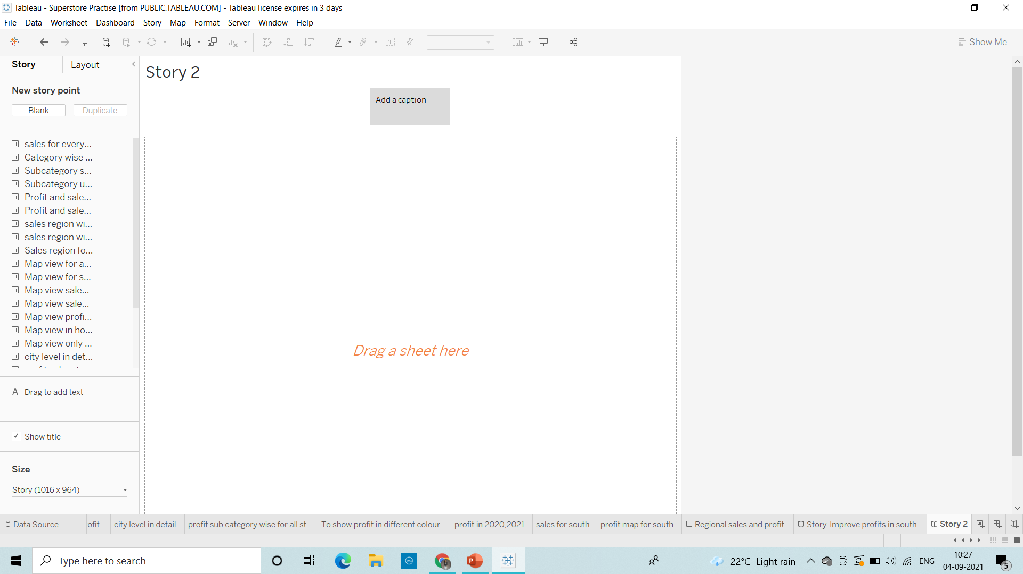
Story Creation Scenarios:
1. Create a story to present all your insights to your team.

Slide 2
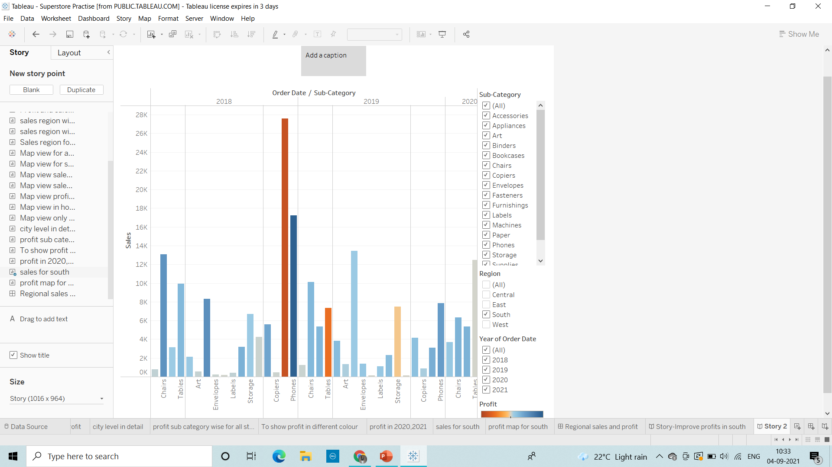
2. Show the sales in the south worksheet in your story.

Slide 3
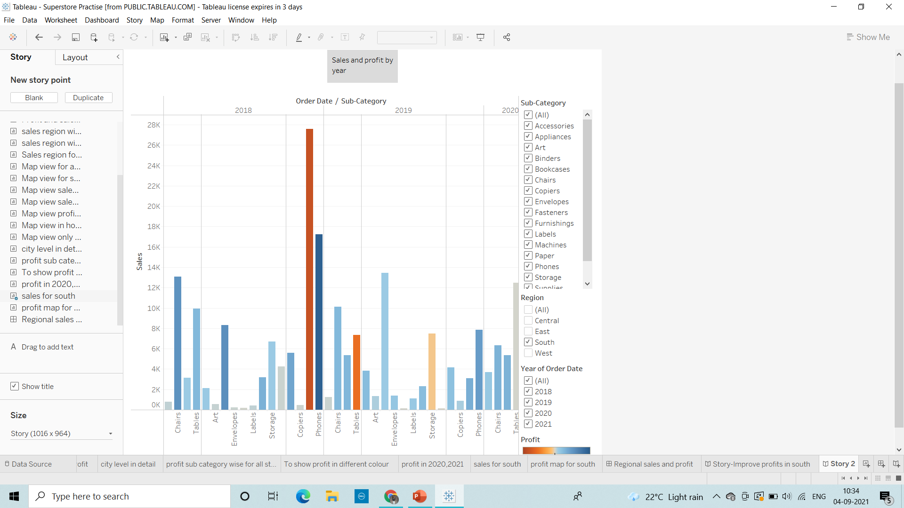
3. Add a caption ‘Sales and profit by year’ to the above story.

Slide 4
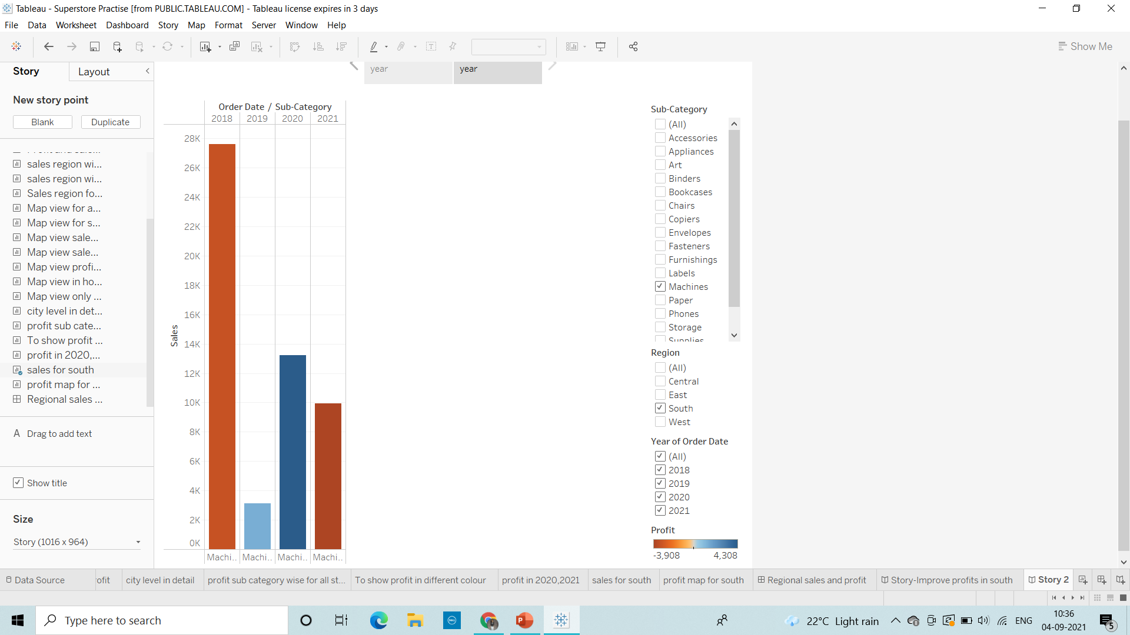
4. Duplicate the first caption and show the story for Sales & profit for machine type subcategory.

Slide 5
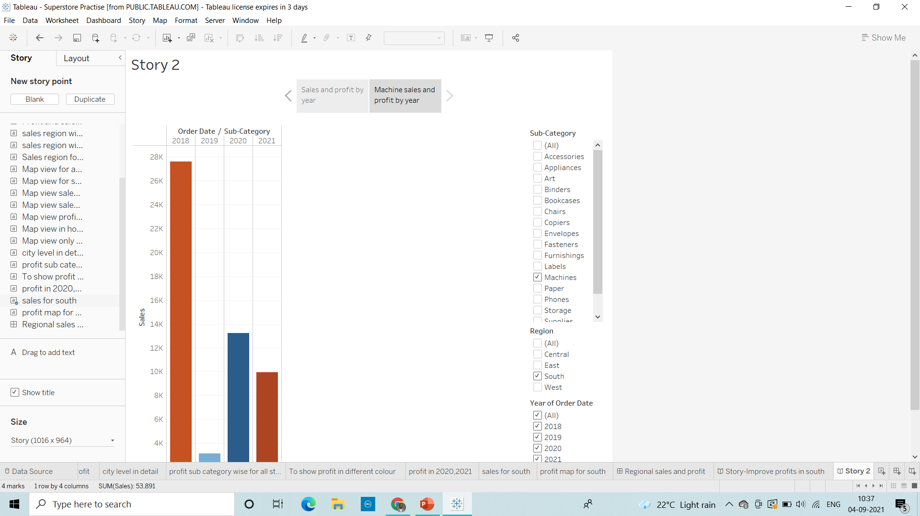
5. Add a caption ‘"Machine sales and profit by year" for Machine type subcategory .

Slide 6
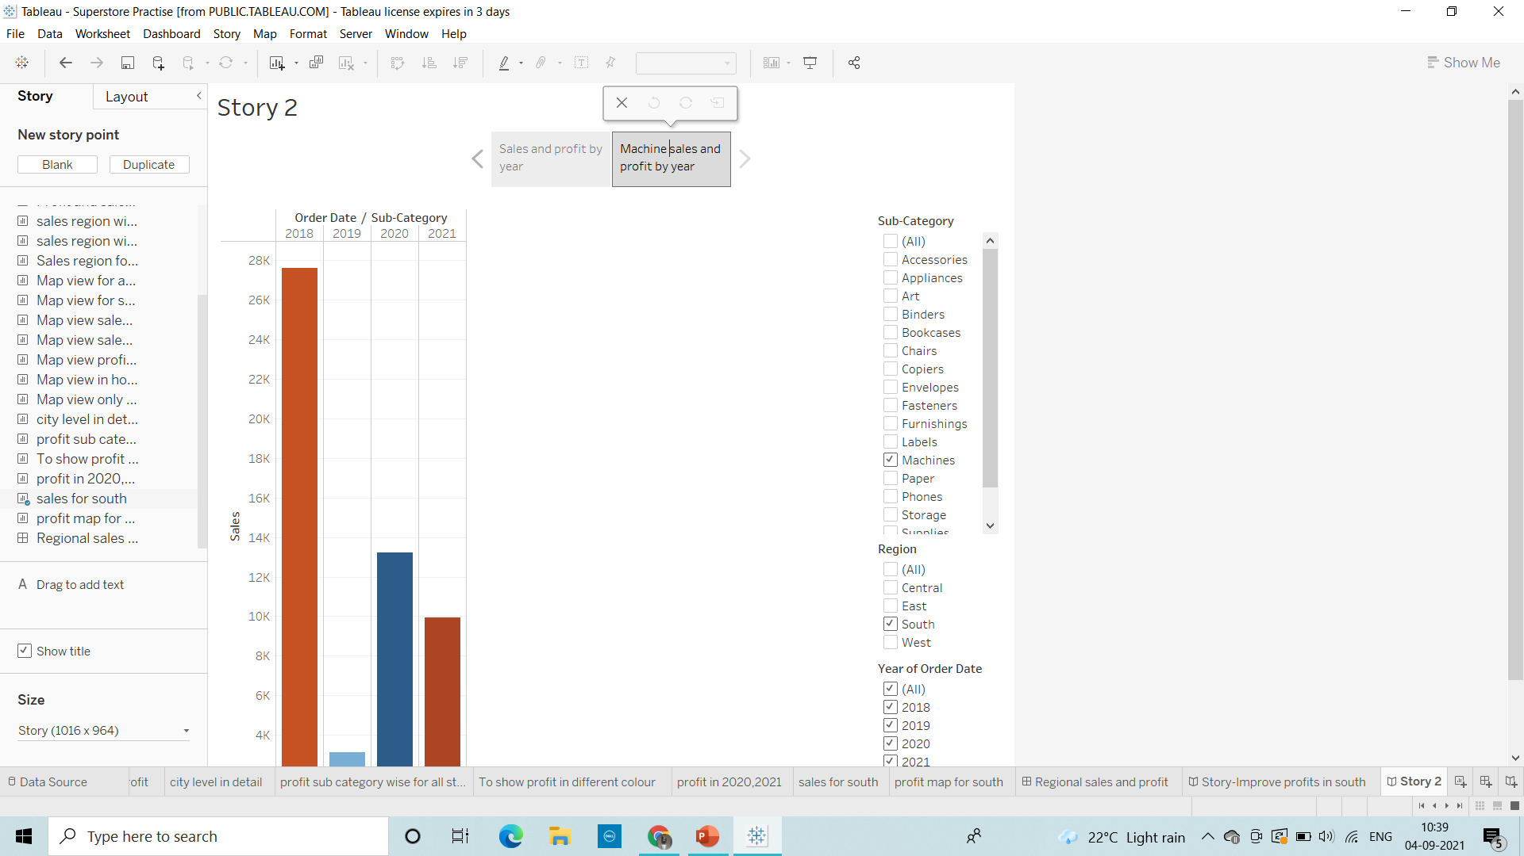
6. Check your Story mini toolbar around the story point caption.

Slide 7
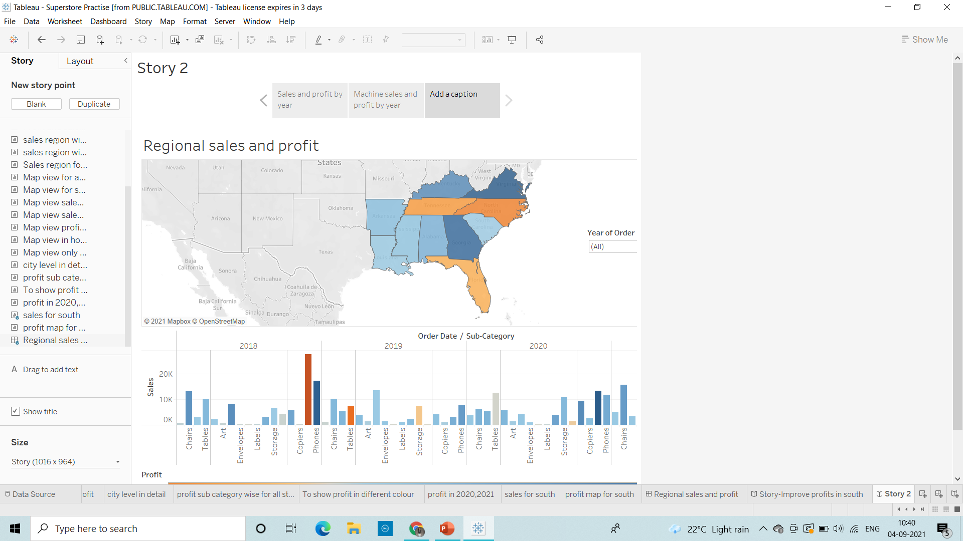
7. select Blank in the Story pane then, drag your dashboard Regional Sales and Profit onto the canvas and find some meaningful insights.

Slide 8

8. Add a caption "Underperforming items in the South“ in the above story point.

Slide 9
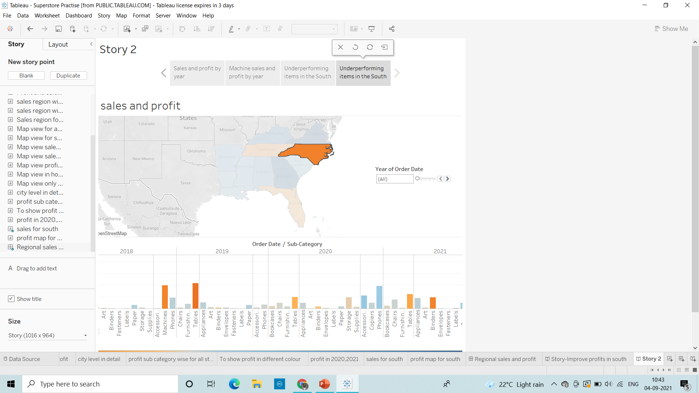
9. Duplicate the above story point and show your result only for north Carolina and all the year.

Slide 10
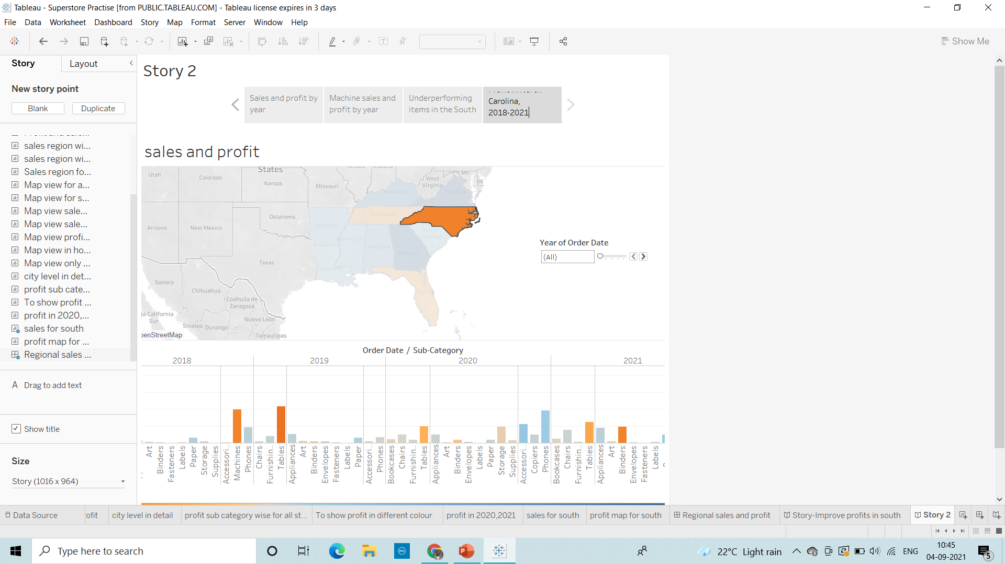
10)Add a caption ‘Profit in North Carolina, 2018-2021’ to the above story point.

Slide 11
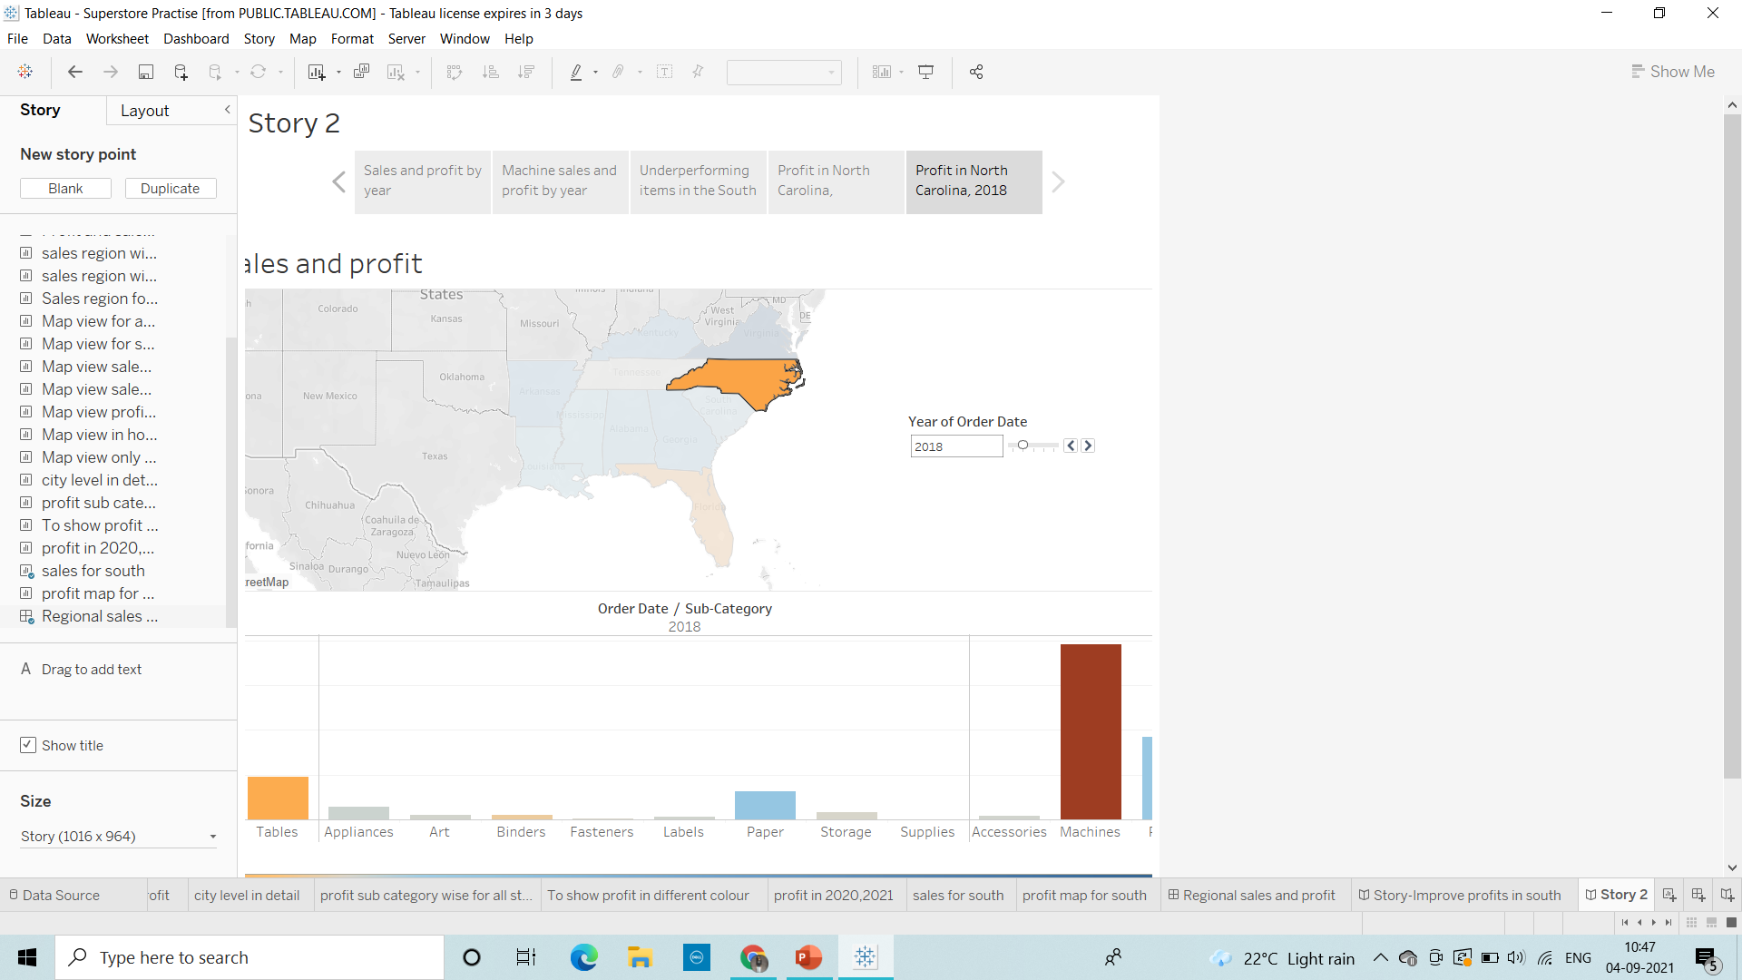
11. Duplicate the above story point and Show the profit in the North Carolina for 2018 and add a caption ‘Profit in North Carolina, 2018’.

Slide 12
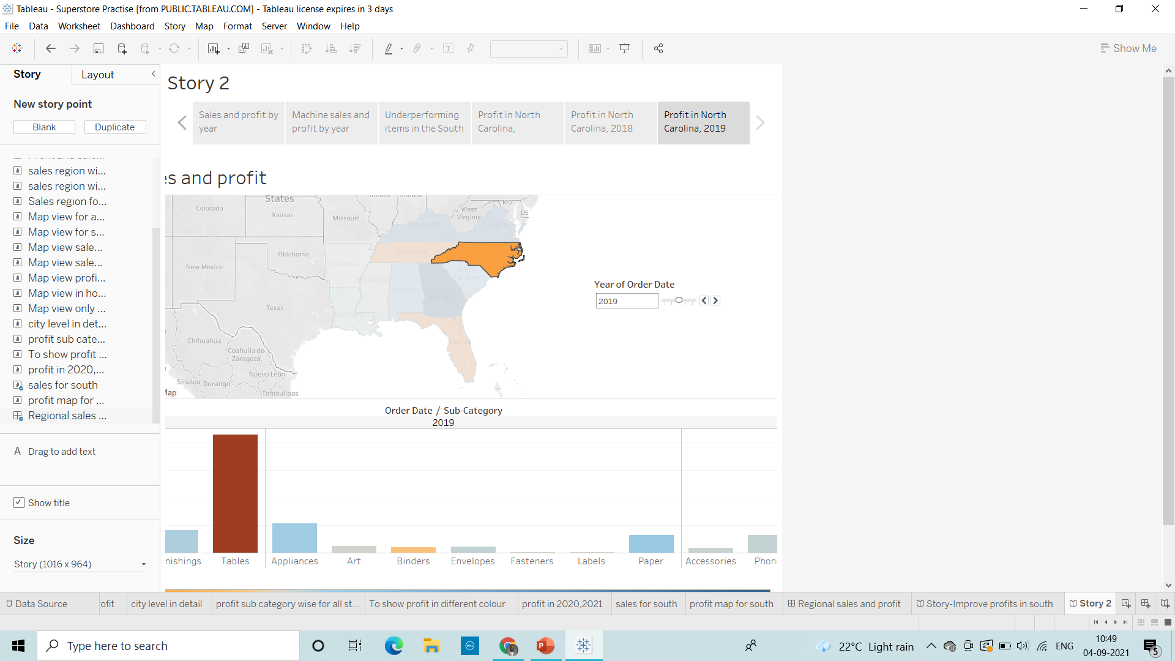
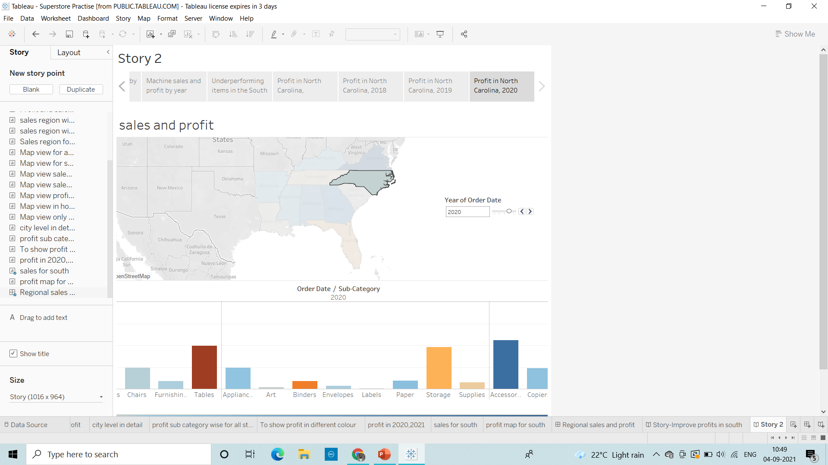
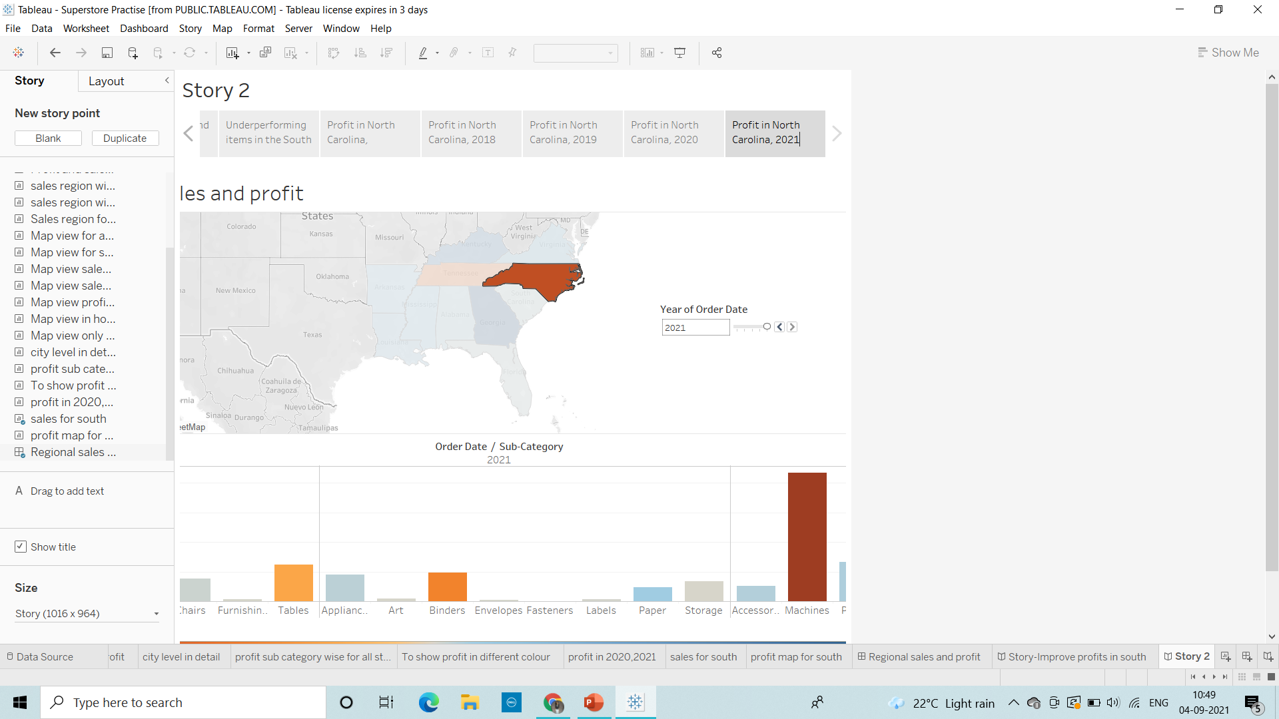
12. Similarly show the profit for North Carolina for every year and add the caption.

Slide 13
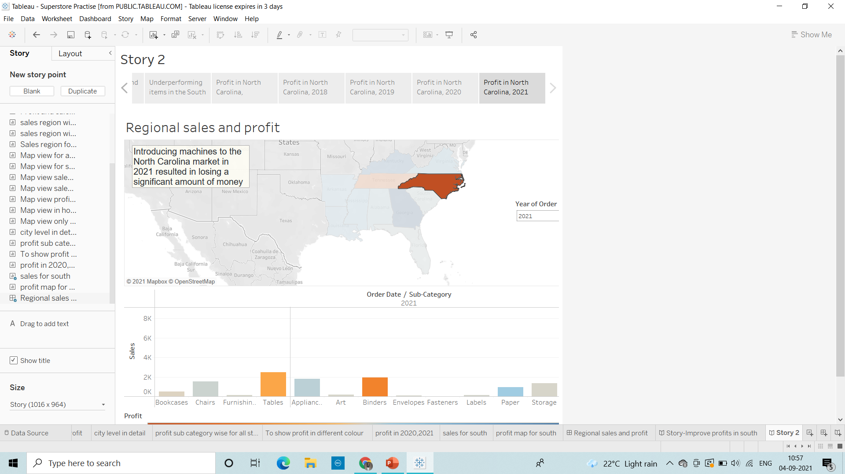
13. Select Drag to add text , drag it onto your view and and enter a description for your dashboard ‘Introducing machines to the North Carolina market in 2021 resulted in losing a significant amount of money.’

Slide 14
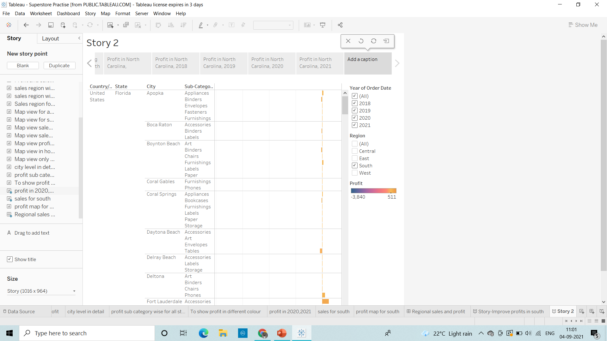
14. From the Story pane, click Blank and drag Negative Profit Bar Chart to the view.

Slide 15
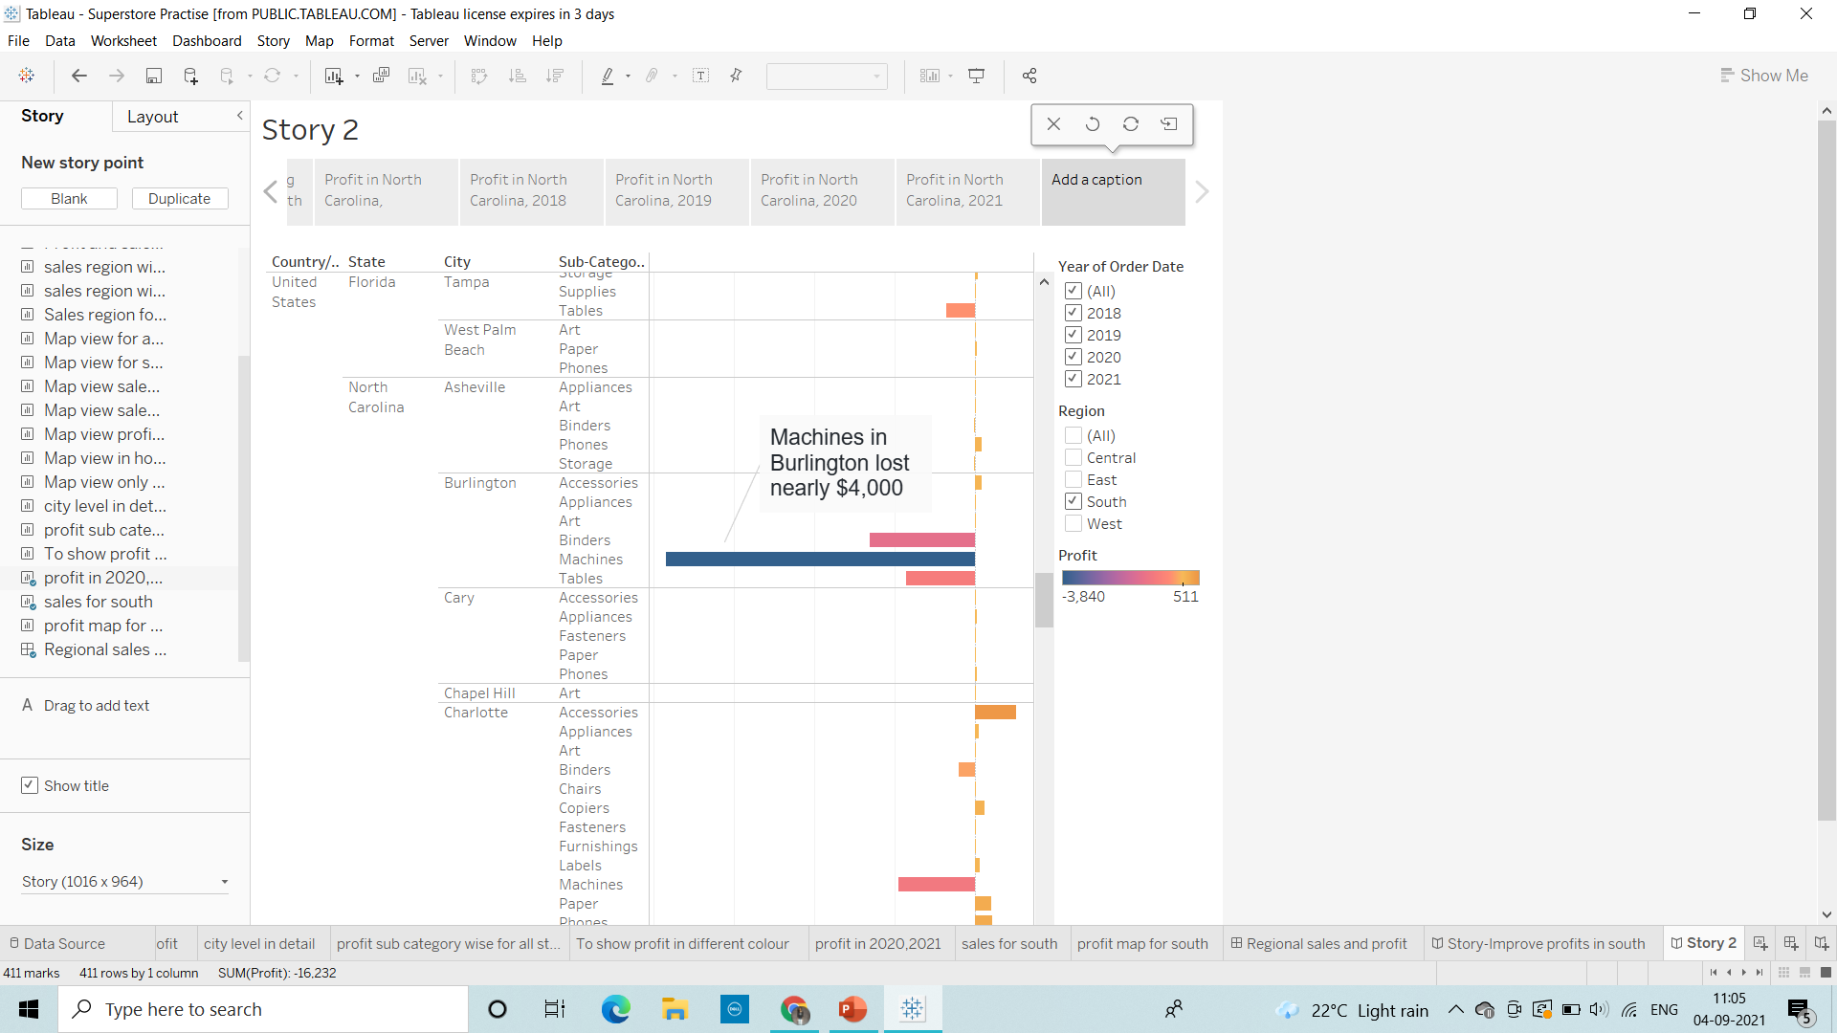
15. right-click the Burlington mark (the bar) and select Annotate > Mark. In the Edit Annotation dialog box that appears, delete the filler text and type: "Machines in Burlington lost nearly $4,000 “.

Slide 16
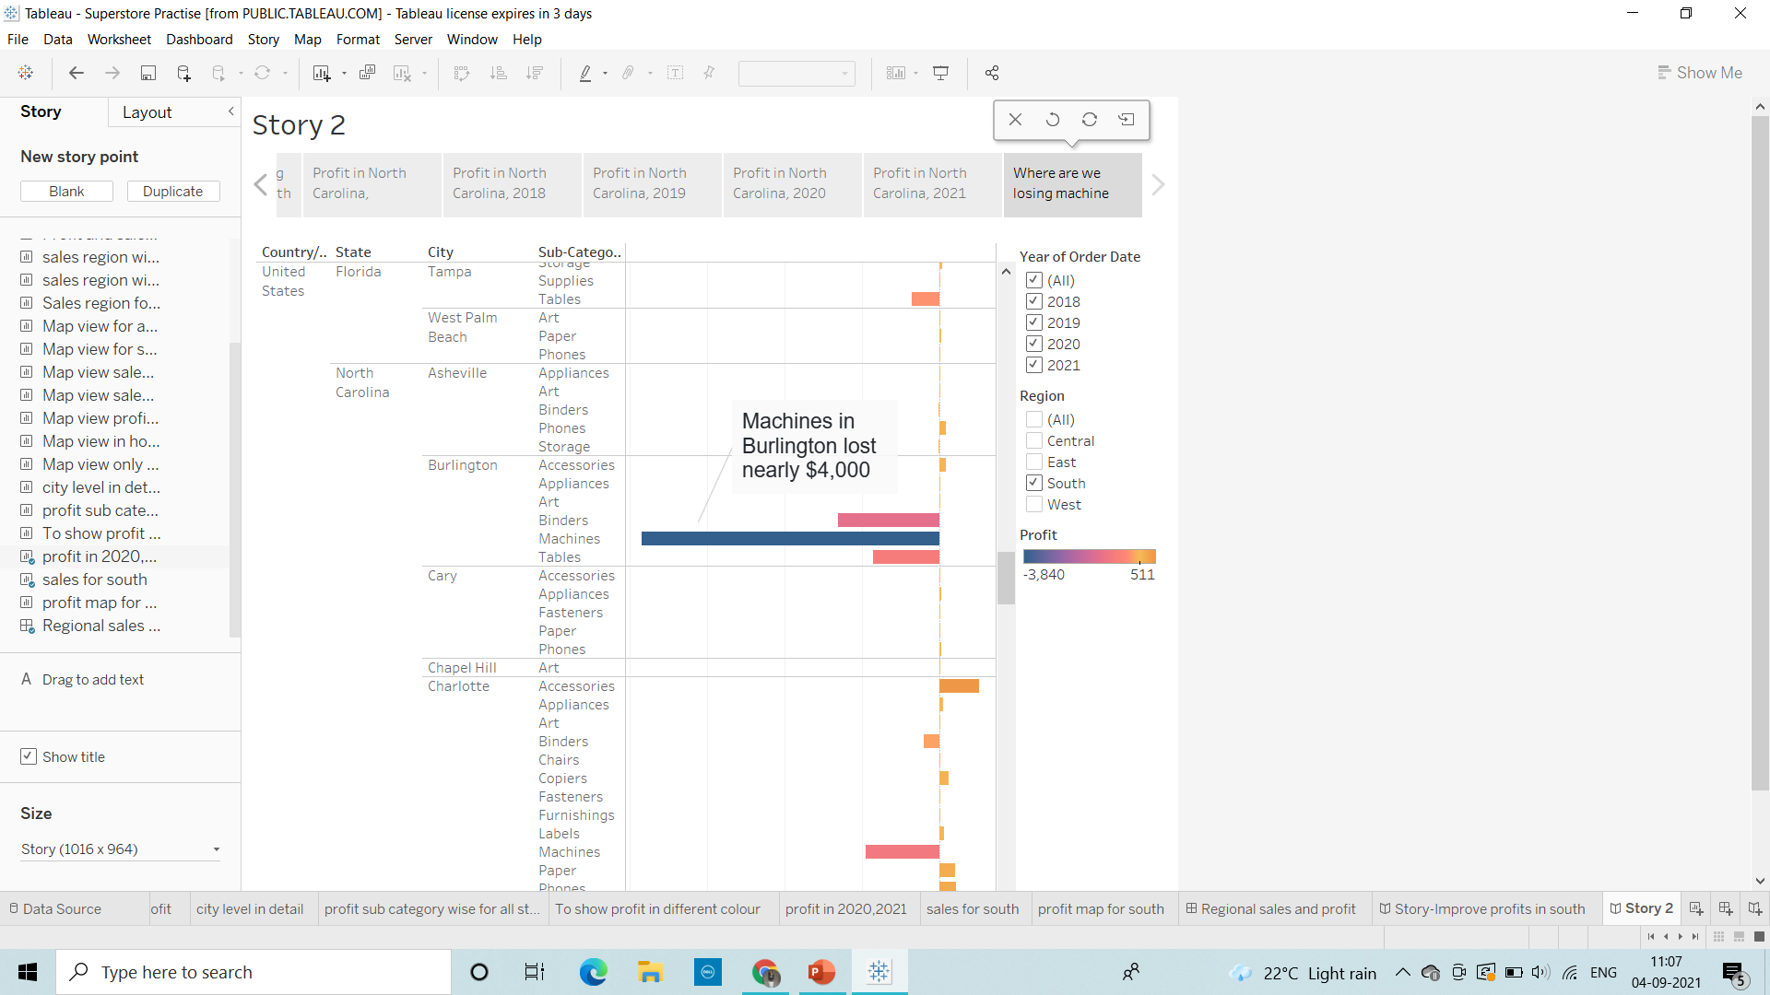
16. Add a caption "Where are we losing machine profits in North Carolina?“ to above story point.

Slide 17
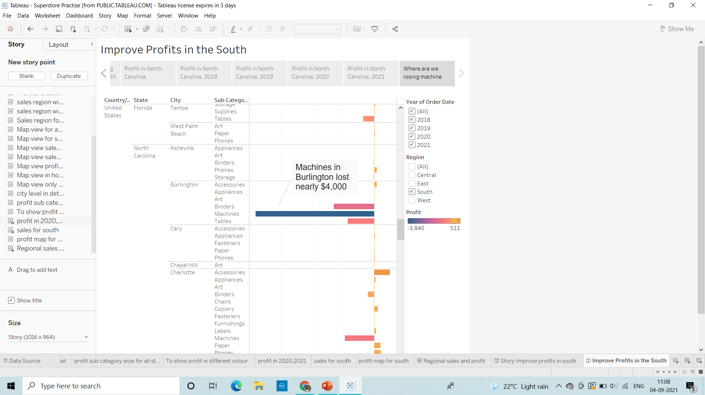
17. Rename your story as "Improve Profits in the South“ and check in the presentation mode.

